Slide 1




NYPD SHOOTING INCIDENT DATA REPORT
Presented by: Ayush Jain

Slide 2

INTRODUCTION AND DATA OVERVIEW
This report analyzes NYPD shooting incidents from 2006 to 2024, covering 29,744 records with 21 variables including incident details, location, and demographics of suspects and victims. The dataset is reviewed quarterly and published by the NYPD, providing insights into gun violence patterns across New York City boroughs.

Slide 3


DATA CLEANING AND TRANSFORMATION
1
2
3
Creation of New Temporal Variables
New variables such as OCCUR_HOUR, OCCUR_DATE, OCCUR_YEAR, and OCCUR_WEEKDAY were created to capture temporal aspects of incidents.
Conversion of Key Variables to Factors
Categorical variables including borough, perpetrator and victim demographics, and location classification were converted to factor types.
Removal of Unused Columns
Coordinate columns X_COORD_CD and Y_COORD_CD were removed to streamline the dataset.

Slide 4
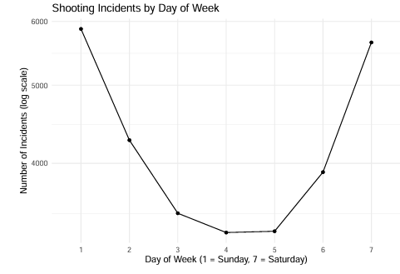
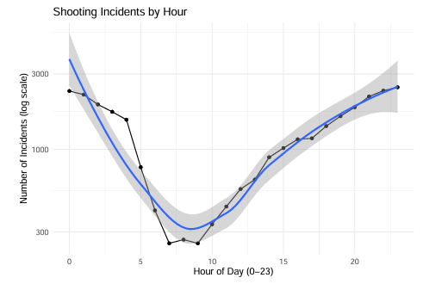
TEMPORAL PATTERNS OF SHOOTING INCIDENTS
Higher Frequency of Shootings on Weekends
Shooting incidents occur more frequently on weekends, particularly on Saturday and Sunday, indicating increased risk during these days. Police patrols can be intensified accordingly.
Peak Shooting Incidents During Nighttime
Shootings peak during nighttime hours
especially from late evening to early morning (around 20:00 to 3:00). Enhanced patrolling during these hours is recommended.

Slide 5
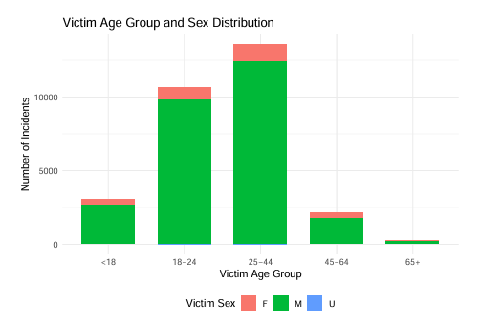
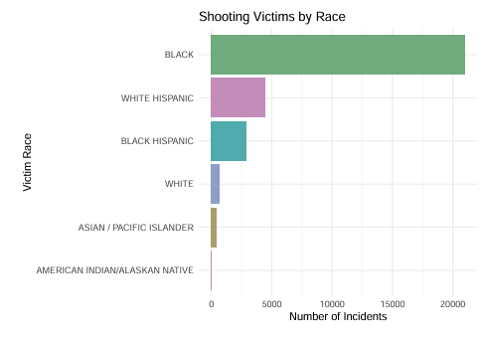
DEMOGRAPHIC ANALYSIS OF VICTIMS
Males aged 25–44 are the most frequent victims, with Black individuals constituting the majority of victims.

Slide 6
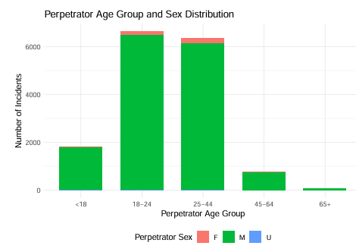
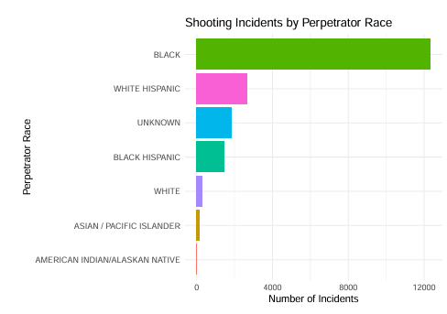
DEMOGRAPHIC ANALYSIS OF PERPETRATORS
Males dominate as perpetrators, especially in the 18–24 age group, with Black individuals representing the largest racial group.

Slide 7
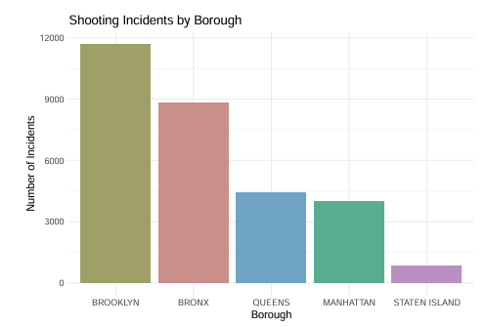
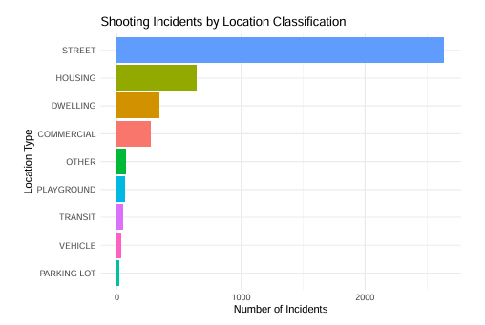
GEOGRAPHIC AND LOCATION-BASED INSIGHTS

Slide 8
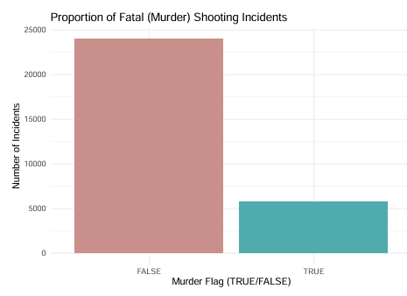
MURDER RATES

Slide 9
PREDICTIVE MODELING OF MURDER OUTCOMES
Objective of Predictive Modeling
The goal is to classify shooting incidents as resulting in murder or not, using complete data records.
Logistic Regression and SVM Models
A logistic regression and SVM models predict murder outcomes based on borough, location type, time, and geographic coordinates.
Model Insights and Limitations
Many predictors show non-significant effects, indicating limited predictive power and the need for further model refinement.

Slide 10
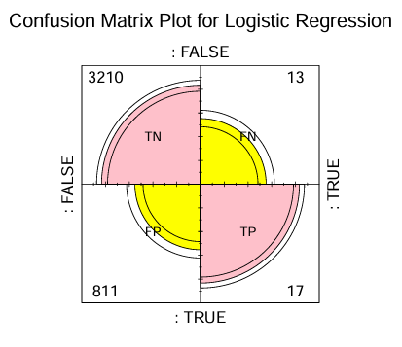
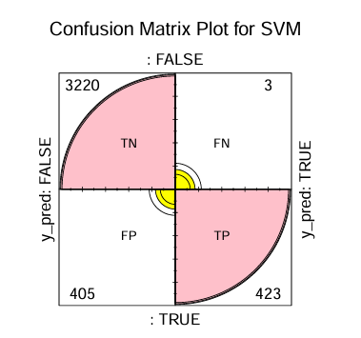
CONFIDENCE MATRIX
LOGISTIC REGRESSION
SVM

Slide 11
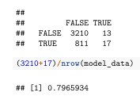
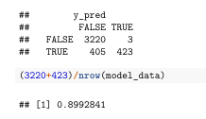
MODEL COMPARISON
LOGISTIC REGRESSION
SVM

Slide 12
CONCLUSIONS AND RECOMMENDATIONS
Increase Police Presence on Weekends : Shooting incidents are more frequent on weekends, especially Saturday and Sunday, suggesting enhanced weekend patrolling could reduce violence.
Focus on Young Males in Brooklyn : Young males aged 18-24 are the majority of perpetrators, with Brooklyn having the highest shooting incidents, indicating targeted interventions are needed.
Strategic Policing Recommendations : Combining temporal and demographic data supports focused law enforcement efforts to mitigate gun violence effectively.

Slide 13
THANK YOU

